Slide 1

WIC Centralized Resource Library
Illinois Department of Human Services
Notes:
hello and welcome to the WIC centralized resource library tutorial. This tool was created to help enhance our abilities to make our DHS materials easier to use and provide to our WIC participants.
We want to thank our WIC Advisory team from 2022, comprised of several WIC Coordinators in Illinois and the 2023 Nutrition Education Workgroup, made up of over 30 WIC staff members all throughout the state. They created this tool and the DHS team edited and finalized the content. A big thank you goes out to them.
We hope this tool pairs nicely with the WIChealth digital catalogue that will be available in late 2023 to provide an enhanced library of much needed resources. We also had heard, that many WIC staff were not aware of all the DHS materials available, so this is also a tool to help facilitate familiarity of the tools currently available. We hope this tool is helpful resource and plan to update this when materials are updated for an easily accessible resource.

Slide 2
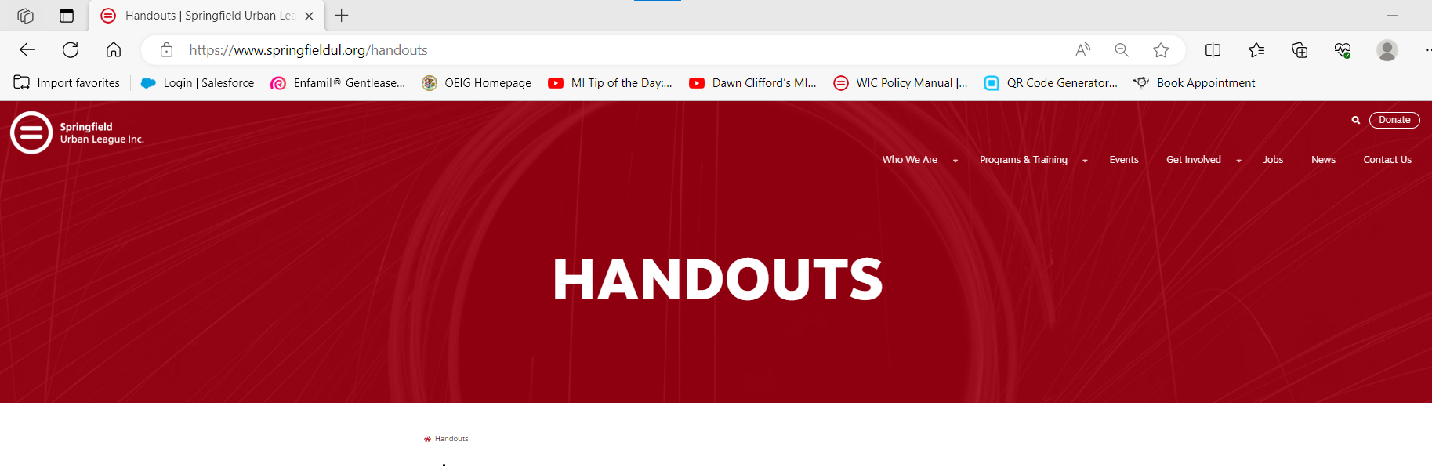
Where to locate this Resource
https://www.springfieldul.org/handouts
Notes:
To find this resource you will go to the CHTC website that's listed on the PowerPoint slide. This directly takes you to where the resource and the DHS order form will be located. it is best to go to this website whenever you utilize this resource to get the most up-to-date version. You will also see the order form that is available to your agency to be able to order DHS paper materials that are available. Please refer to your agencies ordering practices prior to making an order for your agency.

Slide 3
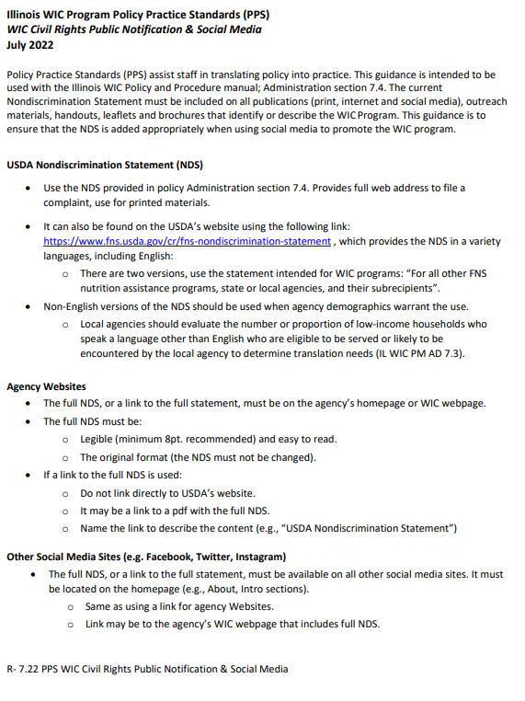
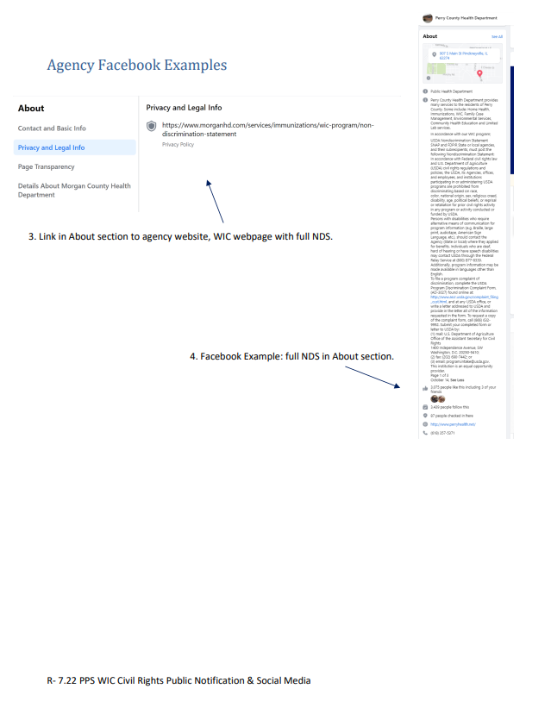
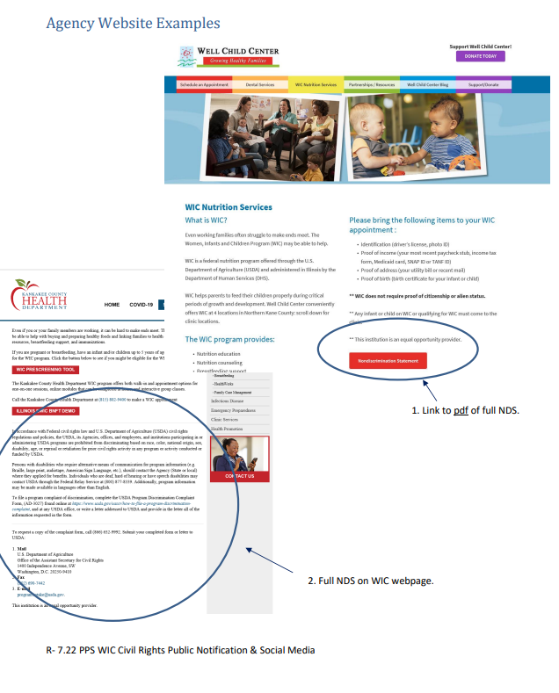
IL WIC PPS WIC Civil Rights Public Notification & Social Media
Community Health Training Center Website:
Programs and Training → Community Health Training Center → Resources → WIC Policy Manual → 7.4 PPS Civil Rights Public Notification and Social Media

Slide 4
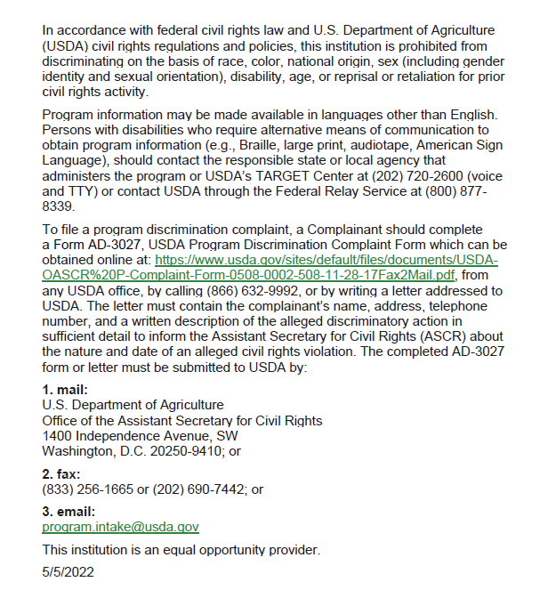
Non-Discrimination Statement
Emailed with memo and accompanying materials on 07/14/2022

Slide 5
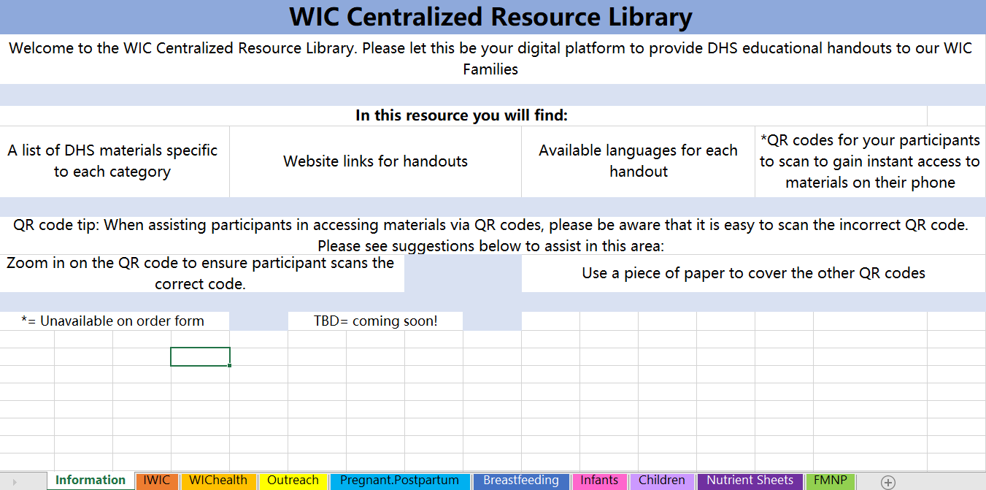
Information Tab
This is the main landing page
This tab has tips for scanning the QR codes and general information about each category of tabs
Notes:
when you click on the link for the centralized resource library the information tab should be the first worksheet to come up. This is where you will find general information regarding the resource library which includes: information about what you will find in this resource, tips when utilizing the QR codes and further information about handouts such as items that are unavailable to order in paper format or materials that will be coming soon. As you can see at the bottom of the page there are multiple worksheets in different colors. Each color represents a different category of handouts that include: Information, IWIC, WIChealth, outreach, pregnant and postpartum, breastfeeding, infants, children. nutrient sheets. and farmers market nutrition program. to access the worksheet you will click the worksheet tab on the bottom. let's first start by clicking the IWIC tab.

Slide 6
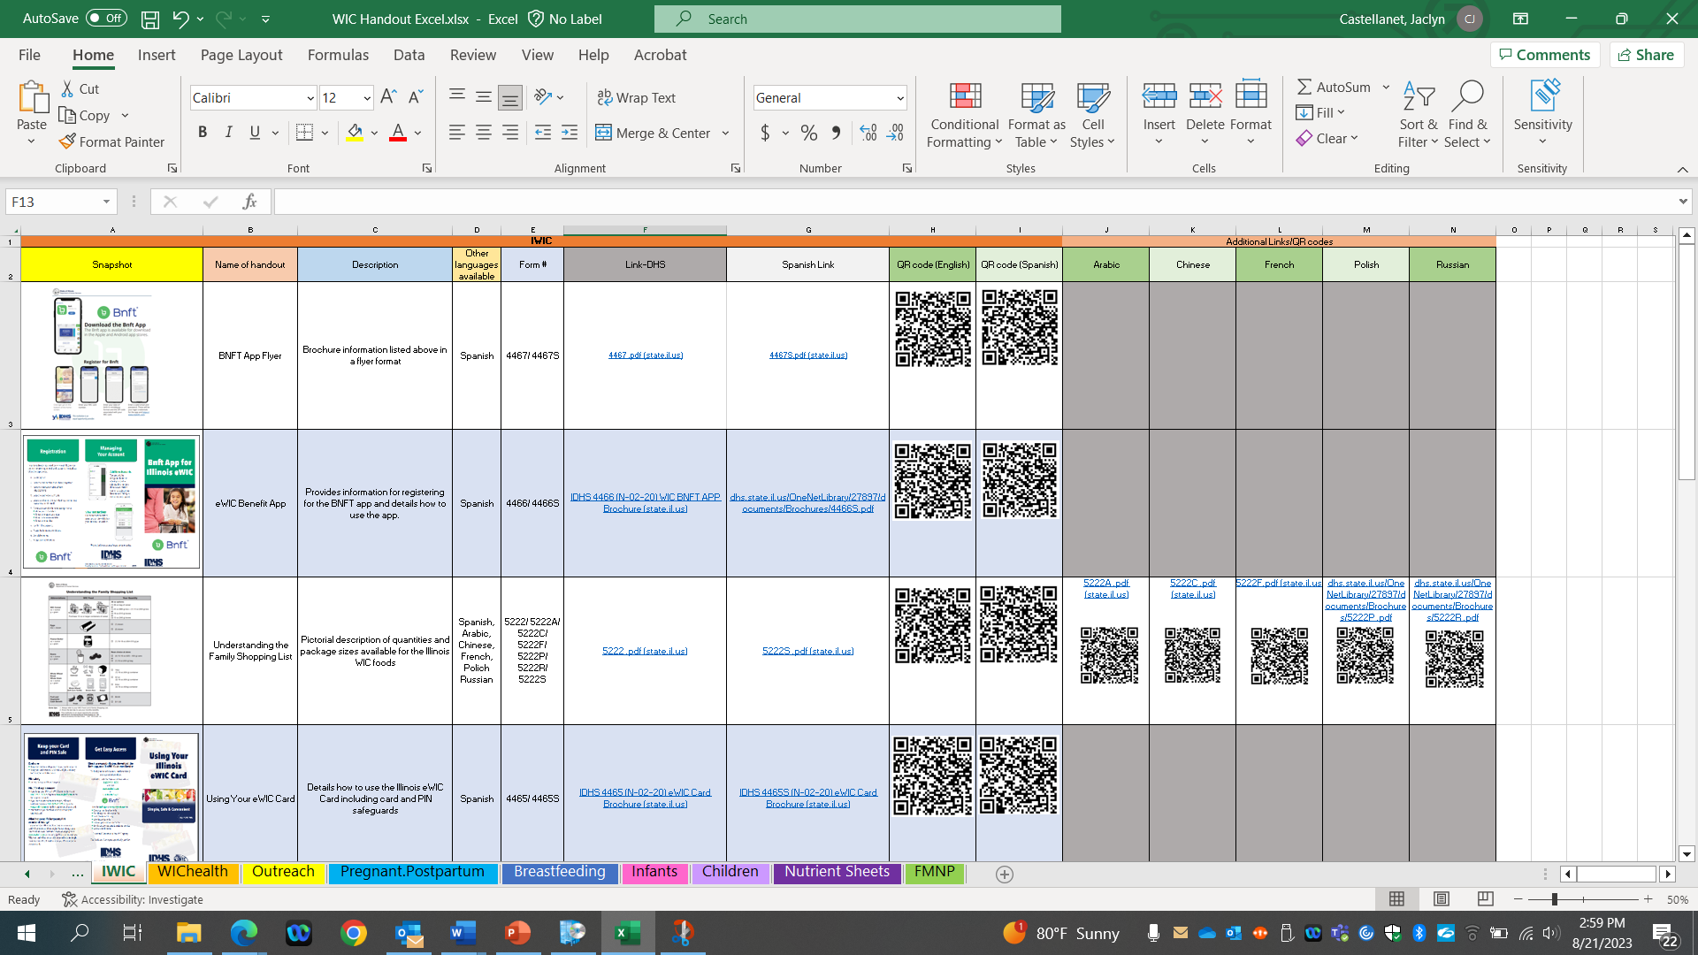
Notes:
After we open our first worksheet you can see the layout of each worksheet in the resource library. If you look at the top it will show the worksheet tab that you are in for example this worksheet tab is (CLICK) IWIC. Now let's work our way through from left to right all of the other headers on this worksheet on the very left you will see the snapshot column. (CLICK)
The snapshot (CLICK)column shows a thumbnail image of the handout. This is intended to jog your memory if you are more of a visual learner and remember brochures based on how they look. This will also give you a quick image of the document at hand to remind you of the handout that you might be looking for (CLICK).
The next column (CLICK) is titled name of handout. This name is the same name as in the order form and gives a generic idea of what's included in the brochure or handout.(CLICK)
Moving right the (CLICK) description column is next. This column provides one or 2 sentences that describes the information included in the brochure or handout. (CLICK)
Moving right is the (CLICK) “other languages available” column. This you will find what other languages are available in that particular handout. (CLICK)
Moving right again (CLICK) is the form number column. This was included so that one could make sure that you're ordering the correct handout or brochure on the order form. You can also look up this form number on the DHS website as well to access the handout. However since we have the links to each of the handout to the right of this column you shouldn't have to do this to access the document. (CLICK)
Moving to the next 2 columns (CLICK) are the link DHS column that provides an English version of the handout or a brochure and a Spanish link to Spanish language handout or brochures that are available for that document. We imagine that you can use the links in multiple ways. Number one you can click on these links during an in person visit to show the individual the handout on your computer screen. You can also use this link to send to a participant who's either there and prefers the handout digitally or who's from Bing service remote and would benefit from this handout being sent via e-mail. (CLICK)
And lastly (CLICK) the QR codes are posted the first column is the English QR code followed by the Spanish, Arabic, Chinese, French, Polish, or a Russian QR code columns. If there is an available QR code or handout in these languages there will be a QR code included below the appropriate column. There are a couple ways you can use the QR codes with participants. number one you can zoom into the specific QR code that you want the in person participant to scan with their phone and have them start to take a picture and click the link that shows up right before they're going to take the picture. this will pull up the handout on their phone without having to type in any links and reduces the need for an e-mail with the link included. Some people have suggested that if you print this out and have this as a desktop reference the QR codes might work easier. Another tip is to make sure you cover the other QR codes to make sure the participant is scanning the correct QR code. (CLICK)
All Worksheet tabs are formatted this same way.

Slide 7
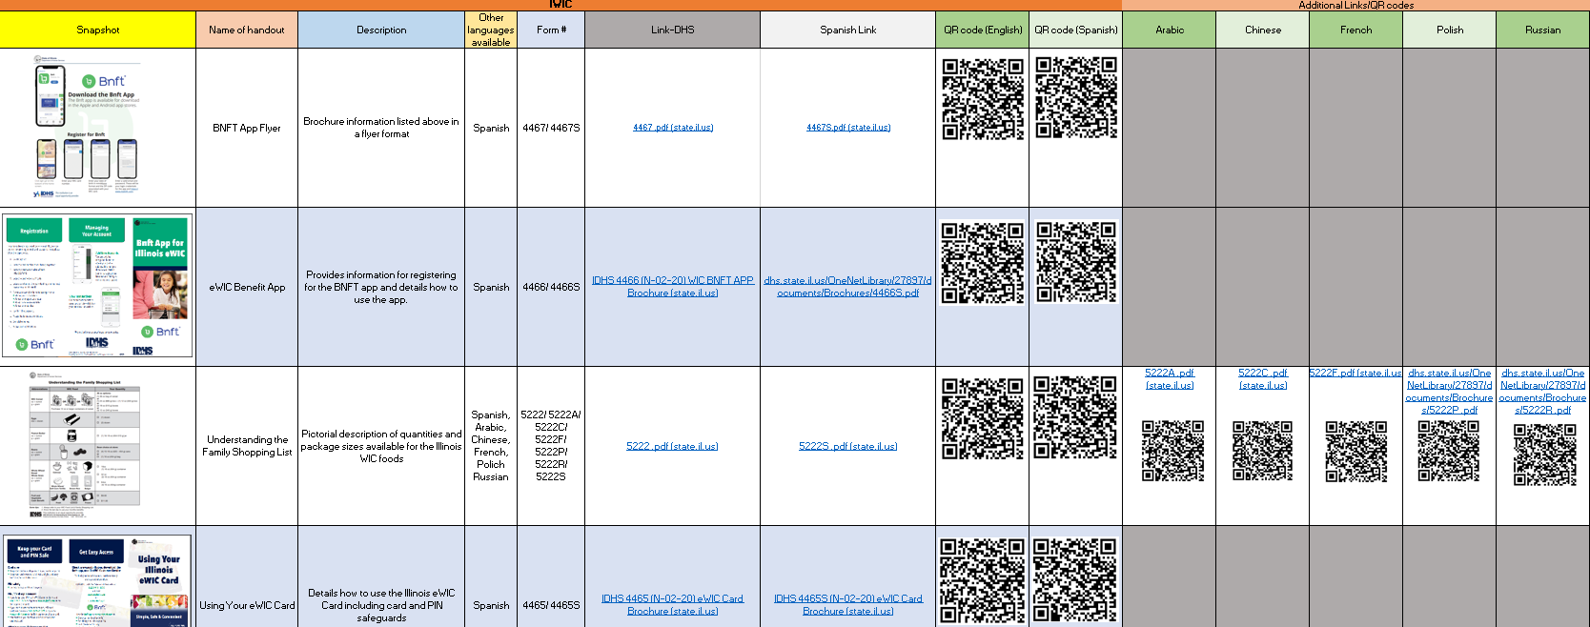
IWIC Tab
These are the materials related to IWIC and the BNFT App
Notes:
Looking at the IWIC tab you will see materials related to programmatic needs are included here. Examples include the BNFT app/EBT card information, Food list, and the medical referral form. The Medical prescribed formulas form is available digitally only due to the fact this handout can get changed annually depending on the contract agreed upon.

Slide 8
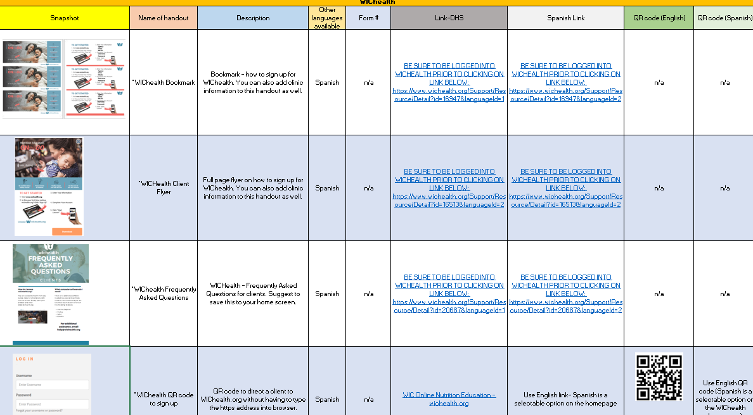
WICHealth Tab
These are the materials related to WICHealth
Before accessing the WICHealth materials, you need to be logged into WICHealth
Notes:
If you open the WIChealth tab, these are materials used to help direct participant to WIChealth and creating an account.

Slide 9
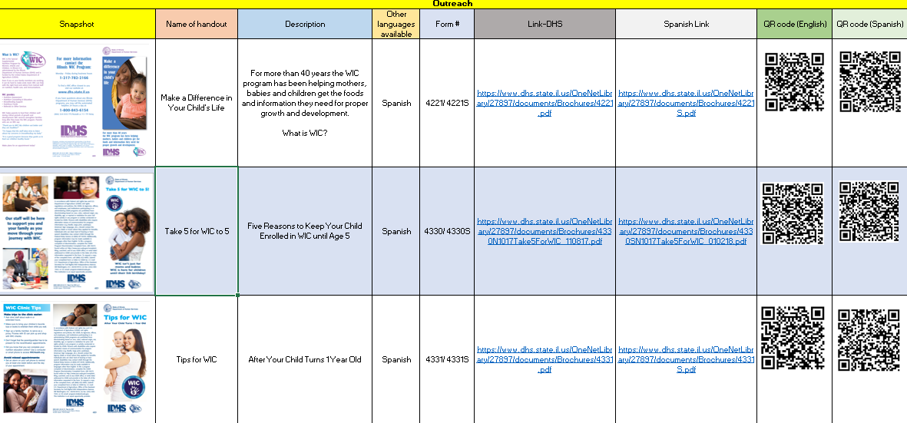
Outreach Tab
These are the materials related to outreach
Notes:
Opening the outreach tab provides materials that are helpful when performing outreach in the community. These include the brochures: make a difference in your child’s life, take 5 for WIC to 5, and Tips for WIC (After your child turns 1 years old)

Slide 10
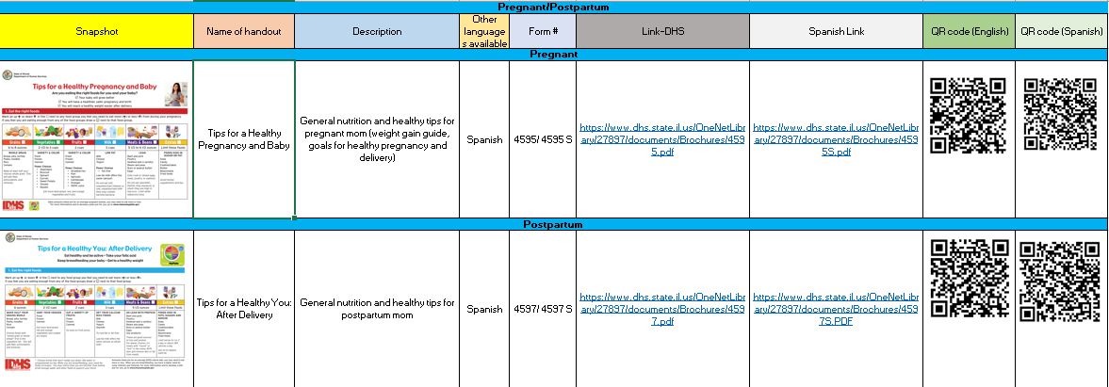
Pregnant/
Postpartum Tab
These are the materials related to the participant categories of pregnant and postpartum
Notes:
The pregnant and postpartum tab is combined as there are limited resources in this area at this time. The two handouts available in here are the tips for a healthy you worksheets. We hope to add more resources to this tab with collaborations with WIChealth materials.

Slide 11
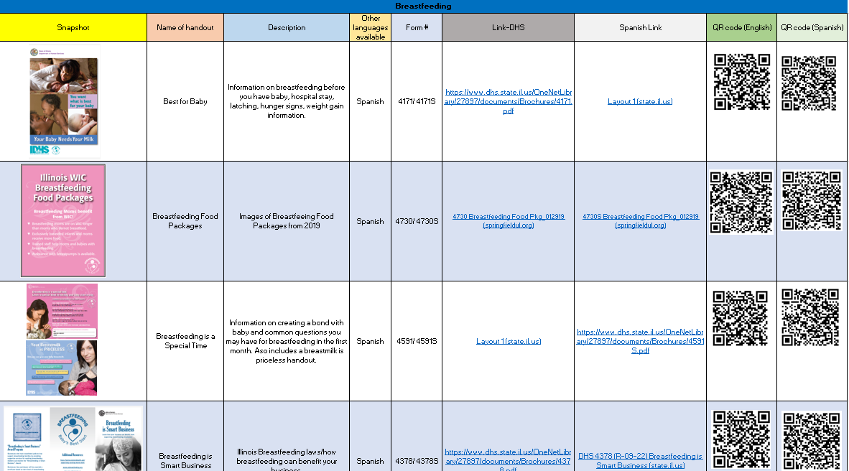
Breastfeeding Tab
These are the materials related to the participant category of breastfeeding women
Notes:
Our Breastfeeding materials are located on the breastfeeding tab includes items such as: best for baby booklet, size of your babies stomach handout and sleepy baby handout. It also lists the hug your baby digital resource links as well. The hug your baby digital resource link is not available to order on this page

Slide 12
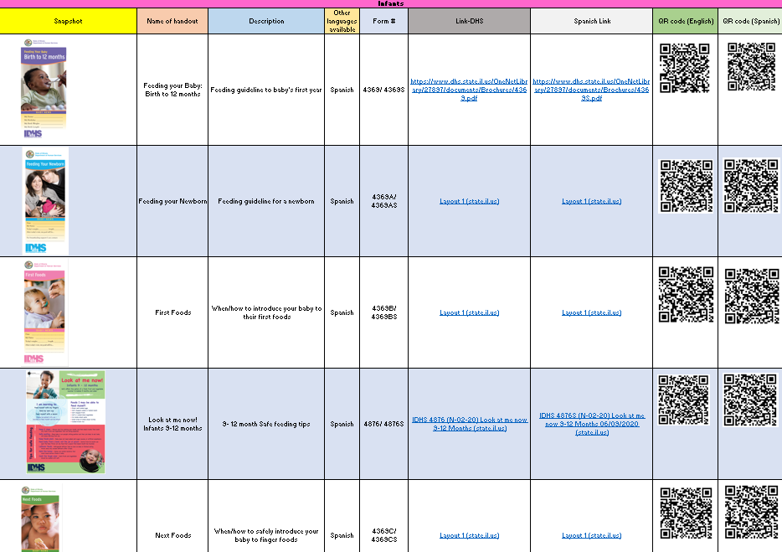
Infants
Tab
These are the materials related to the participant category of infants
Notes:
When opening the infant tab, you will find many handouts relating to infant feeding that have been developed over the years. Now that we have a catalogue set up, we plan to look back on these handouts to update them. When updating any handouts at DHS, we plan to update this digital resource for ease of access as well. You will find the new formula handouts available in this worksheet as well.

Slide 13
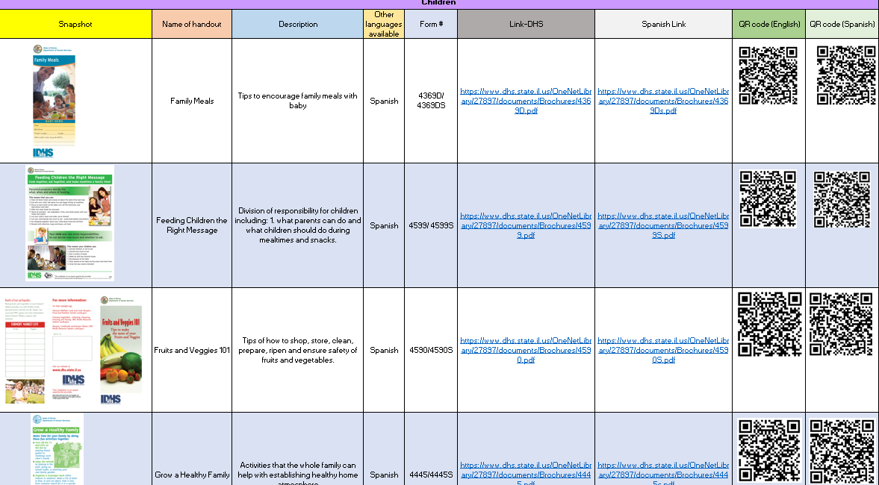
Children
Tab
These are the materials related to the participant category of children
Notes:
On the children’s tab, you will find current handouts about fruit And vegetables, family mealtimes and lead.

Slide 14
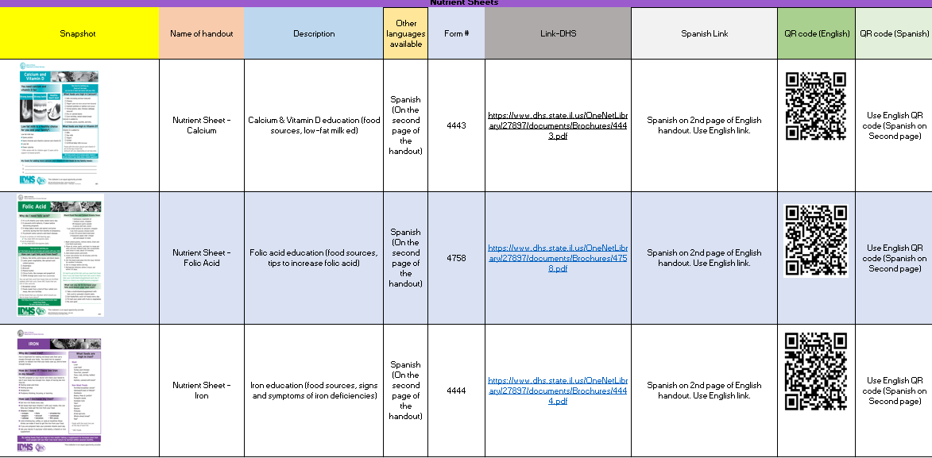
Nutrient Sheets
Tab
These are the materials related to the nutrient sheets
Notes:
On the Nutrient Sheet tab, it includes all Nutrient Sheets for Calcium, Folic Acid and Iron. They are on their own worksheet, as they are applicable to many categories.

Slide 15
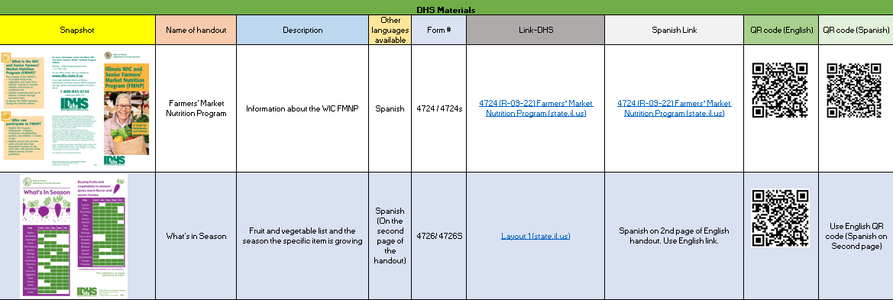
DHS- FMNP Materials
Tab
These are the state developed materials related to Farmer’s Market Nutrition Program.
Notes:
And lastly, is the Farmers market nutrition program materials.
This is the end of the tutorial. We hope you will take the time to explore the library on your own and flag the handouts that are most helpful to you!
Thank you so much for your attention.

