Slide 1
Explanation of WIC Foods Benefits Letter
Process for Local Agencies
This Photo by Unknown Author is licensed under CC BY-SA-NC

Slide 2
Collaborating to Assist WIC Families
Healthcare and Family Services (HFS) may authorize coverage for Participants with a current IL Medical Card* for:
MPF formulas in excess of what WIC offers
MPF formulas not on the IL WIC Formulary
No oral intake, fed 100% via a feeding tube
Participants must go through a Durable Medical Equipment (DME) provider in order to receive their prescribed formula
CPA expected to determine if/when a referral letter is needed
This Photo by Unknown Author is licensed under CC BY

Slide 3
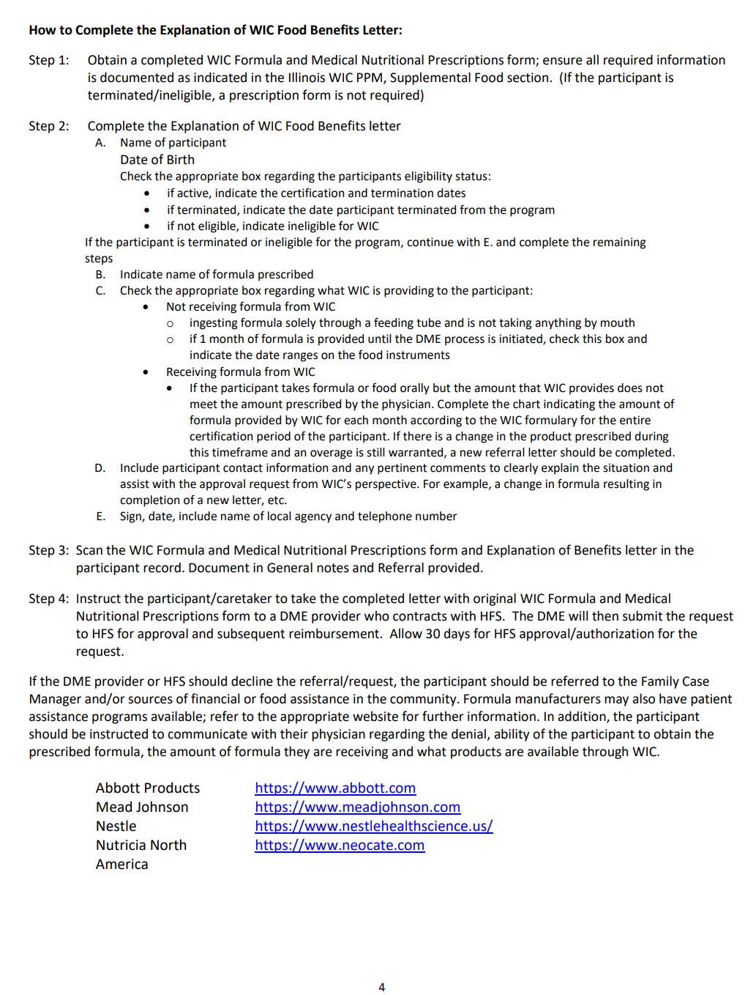
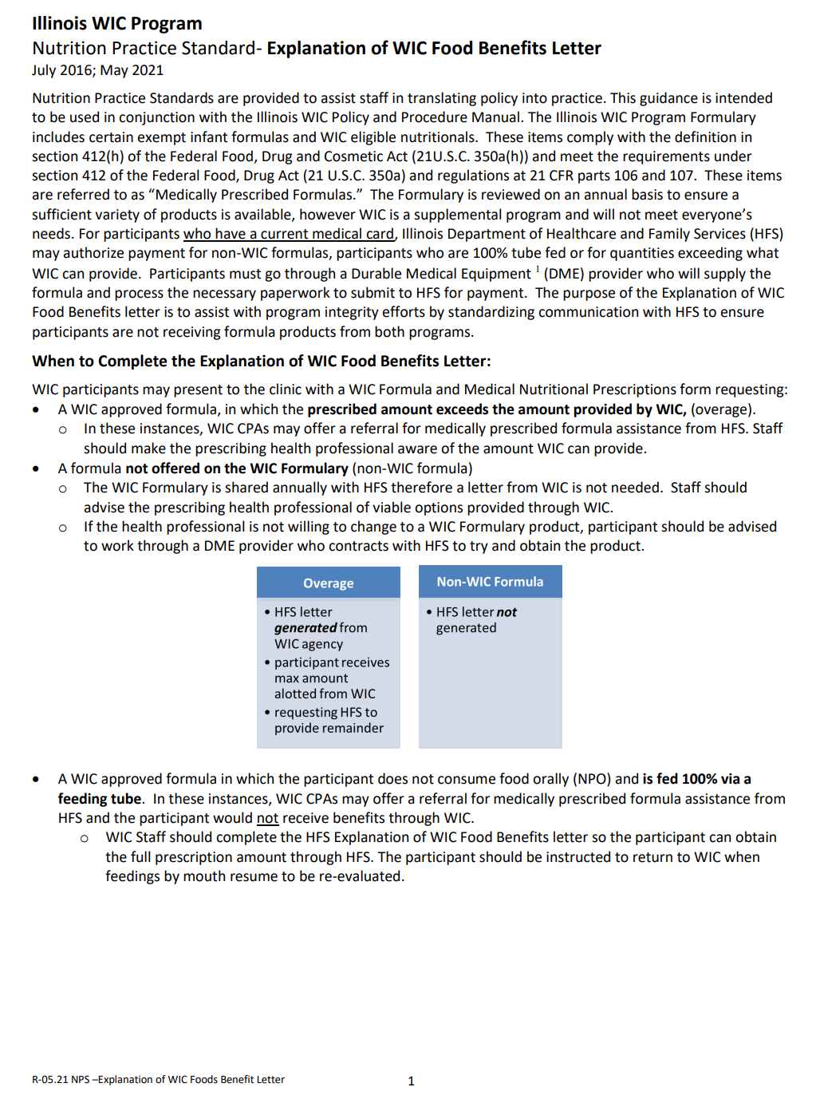
NPS: Explanation of WIC Foods Benefits Letter
Guidance for process
IL WIC PM SFD 6.4
https://bit.ly/3jpTPaI

Slide 4
When Do I Complete a Referral Letter?
Oral Intake:
Amount of formula physician prescribes exceeds what WIC provides
Tube Fed:
All participants who are 100% tube fed and on a WIC formula (includes those active, termed or ineligible)
Participants who are partially tube fed, but amount of formula physician prescribes exceeds what WIC provides

Slide 5
When Do I Complete a Referral Letter?
Oral Intake:
Physician prescribes a formula that WIC does not provide
Tube Fed:
Individuals who are 100% tube fed, never certified on WIC
Participants who are partially tube fed and WIC is providing all formula prescribed by physician

Slide 6
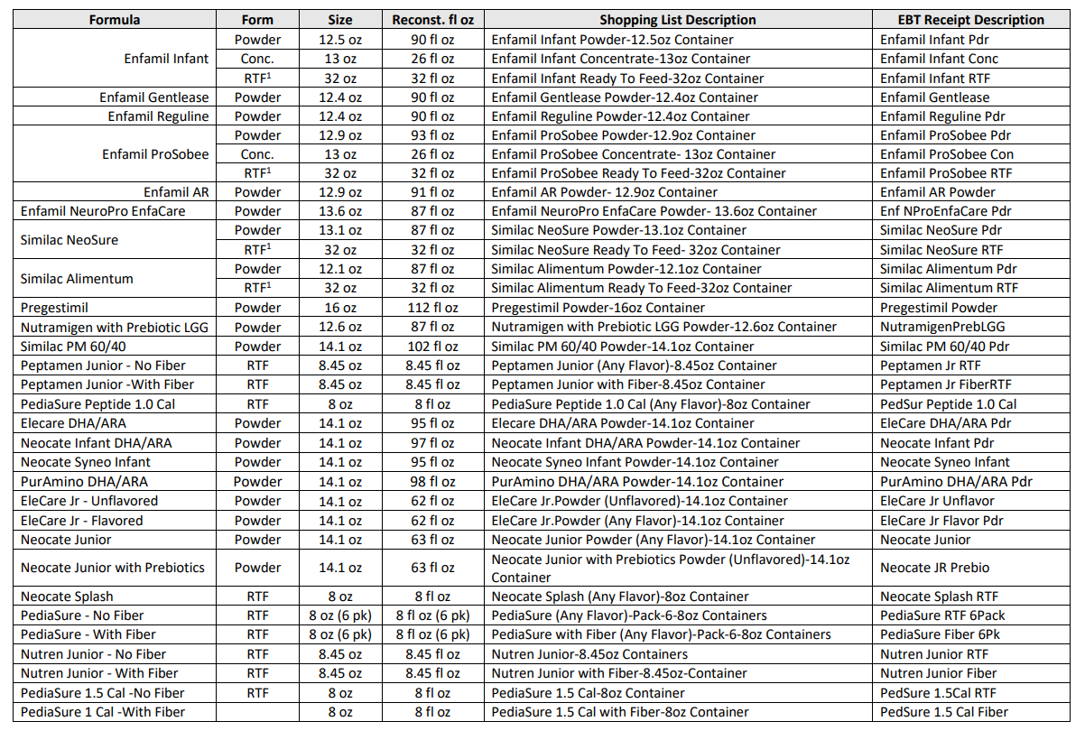
Food for Thought
When determining if you have a formula overage, where and how would you identify the maximum amount of formula provided by WIC?
The Illinois WIC Food Package Tables (Addendum IL WIC PM SFD)
Find formula, take reconstituted fl oz per container and multiply based on how many containers are provided by WIC (monthly)

Slide 7
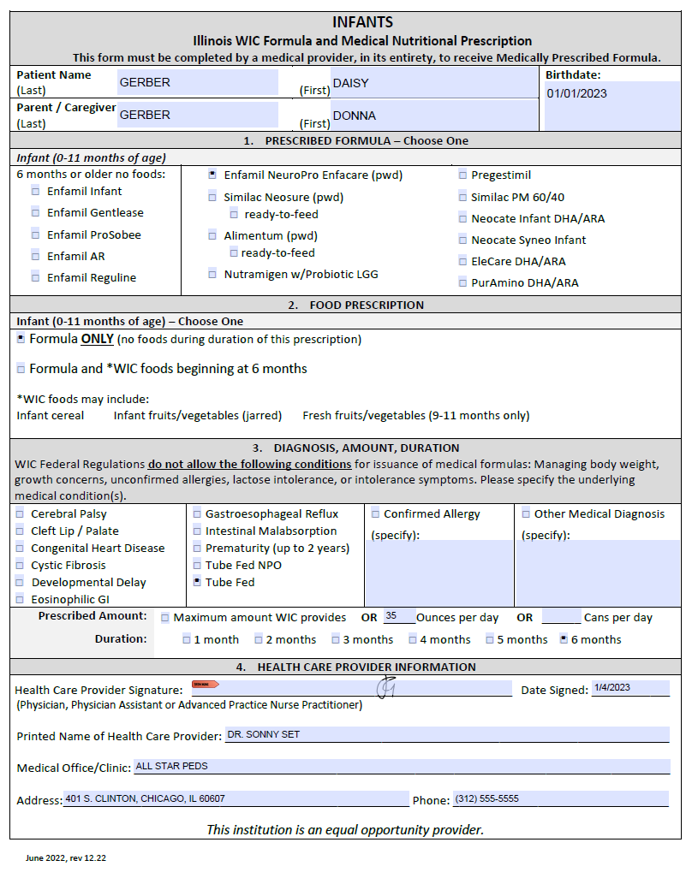
Let’s take a closer look…
Per month Daisy needs 35oz/day (1,085 oz for January)
1 container Enfacare = 87 oz
X 10 containers provided by WIC for the month
_______________________
870 fl oz/month
provided by WIC
215 oz of Enfacare Powder is still needed for the month
This is an overage

Slide 8
Food for Thought
Can a WIC participant remain on the WIC program, if they are receiving assistance from DME?
A Participant/Household may choose to remain on WIC when working with DME, however they will not be issued more formula benefits than are prescribed
Might be easier on Household: time, money, transport not to come to WIC until needed
This Photo by Unknown Author is licensed under CC BY-SA

Slide 9
Let’s take a closer look…
Partial tube fed/oral on a non-WIC formula, where foods are taken by mouth
100% tube fed/npo
Foods may be provided, if the family chooses to stay on WIC and continue their appointments
Contact WIC when oral feedings resume

Slide 10
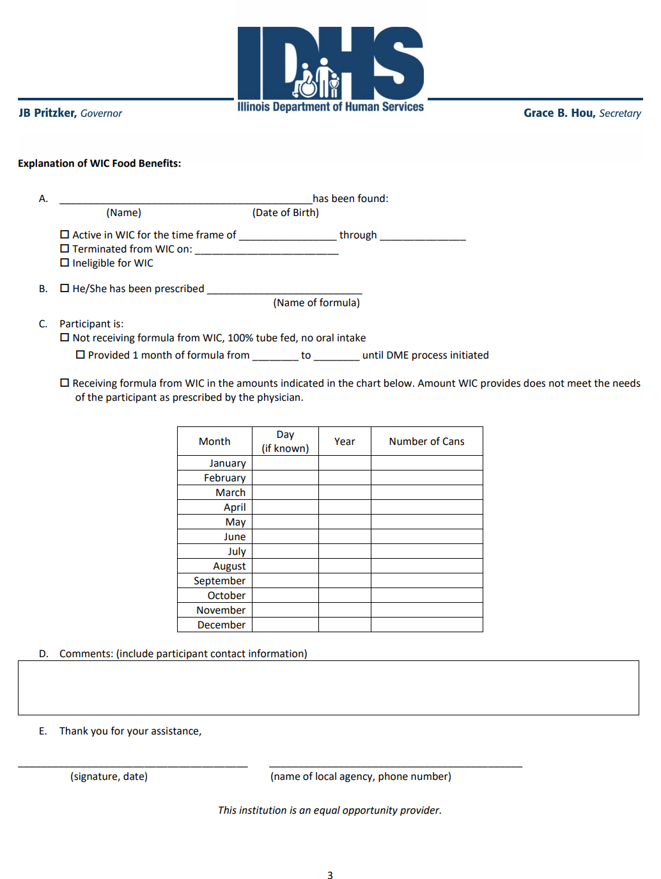
Determine if the WIC Pt has a:
IL Medical Card
Completed Prescription Form
Complete HFS letter
Keep scanned copies in the Participant’s I-WIC record:
Completed Prescription Form
Explanation of WIC Foods Benefit Letter
Document in MIS: Note & Referral
Instruct family to take documents to the DME provider- allow 30 days for approval
Issue 1-2 months of formula benefits to allow for the HFS process to be implemented (if prescribed a WIC approved formula)

Slide 11
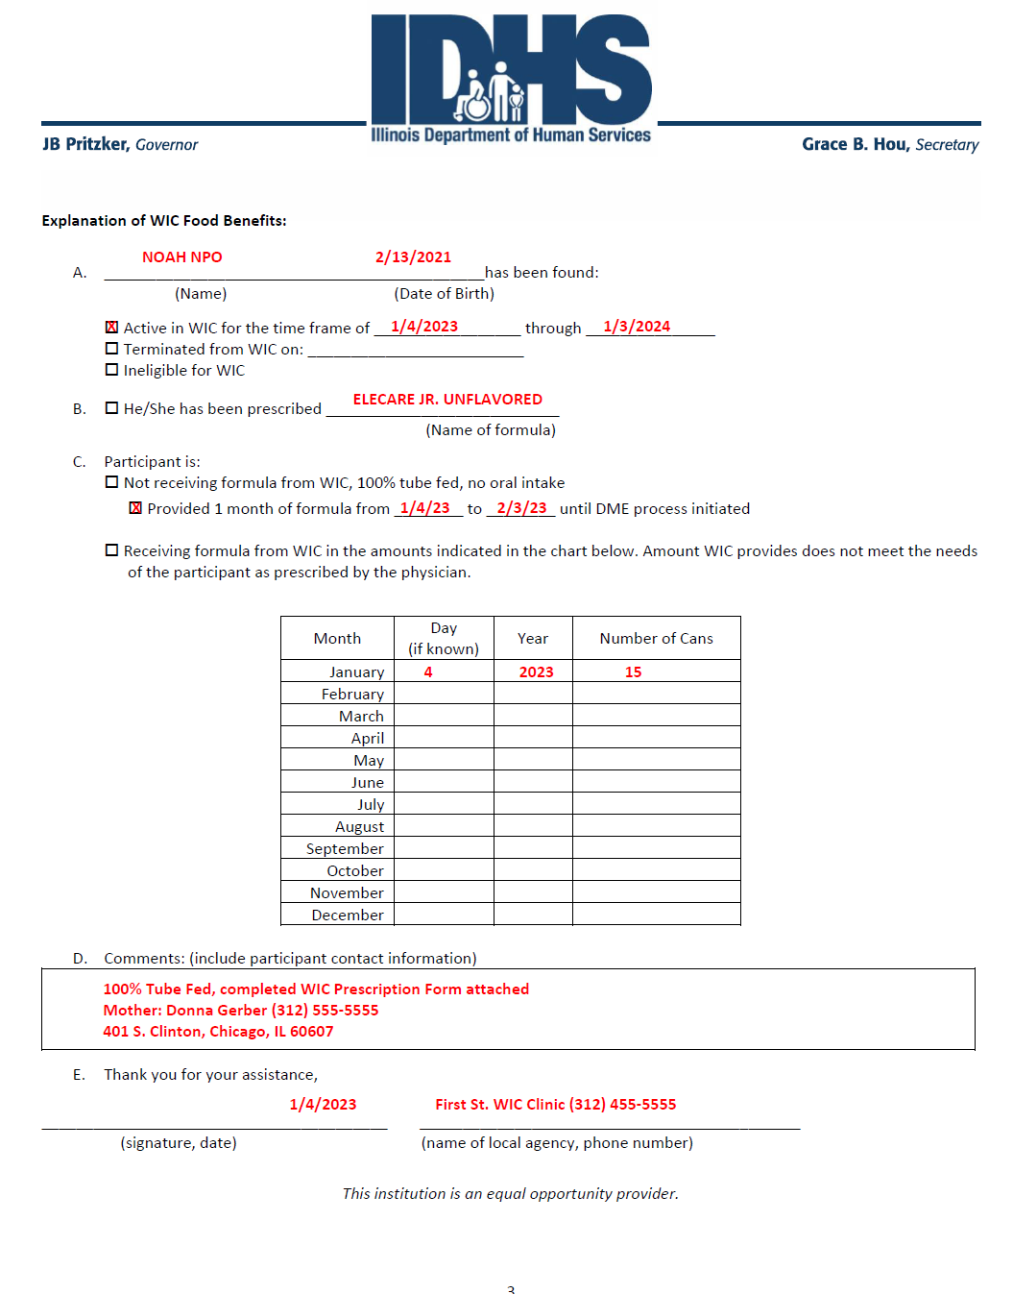
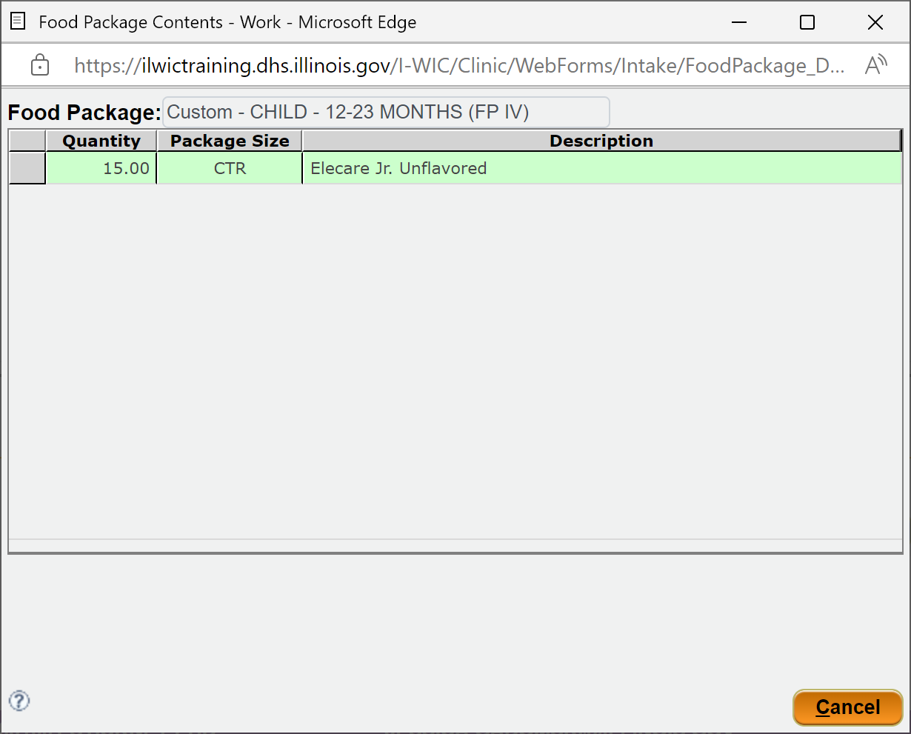
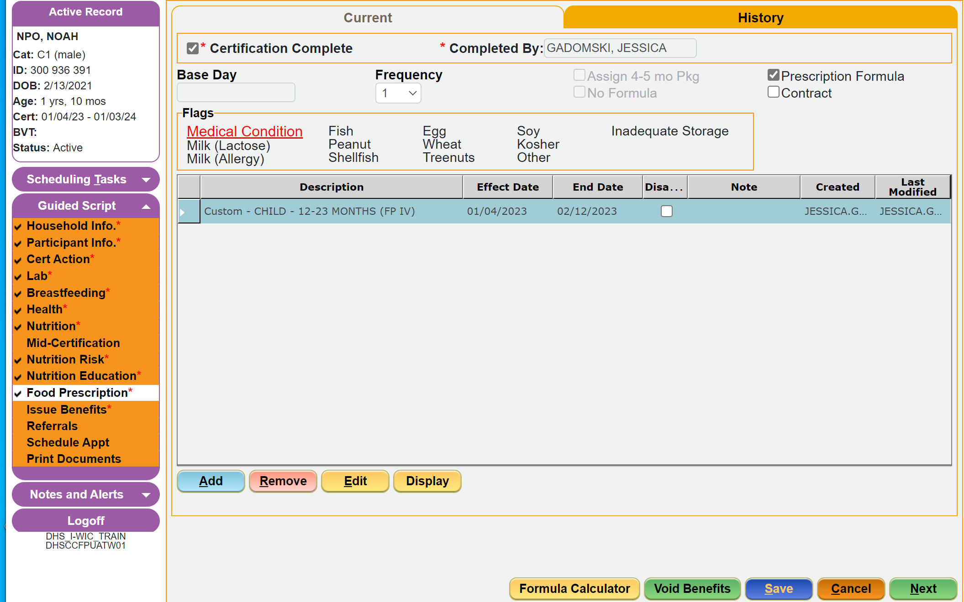
Let’s take a closer look…
Please let us know the status of your DME referral…

Slide 12
Knowledge Check
What documentation is needed in the WIC MIS (I-WIC) when a referral letter is provided?
In addition to scanning the completed:
WIC Prescription Form
HFS Referral Letter
A general note must be entered, and Referral made on the Referral screen in I-WIC
This Photo by Unknown Author is licensed under CC BY-SA-NC

Slide 13
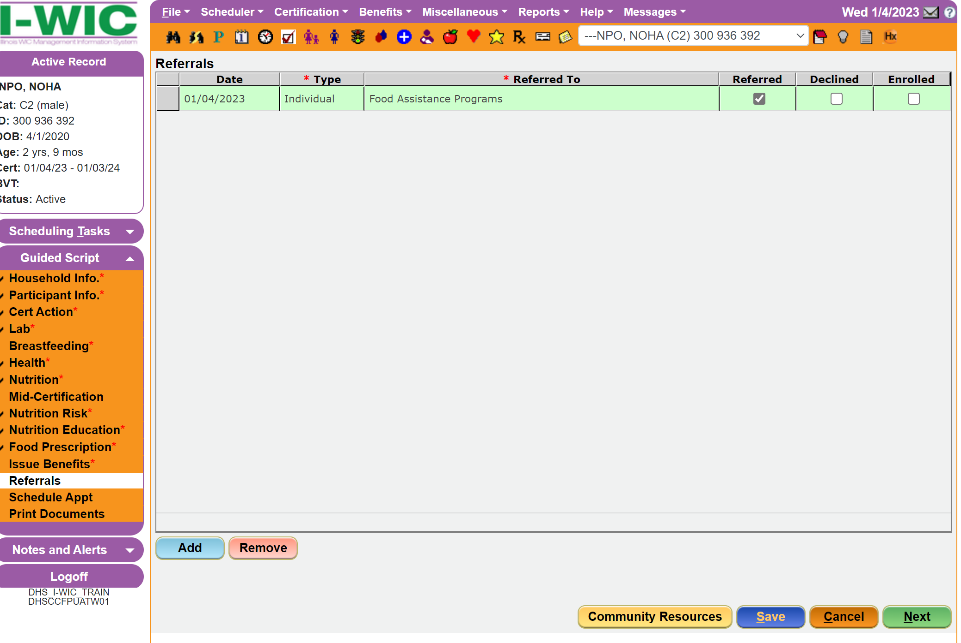
Let’s take a closer look…
Reference NPS: Documenting in WIC MIS for more information on system documentation

Slide 14
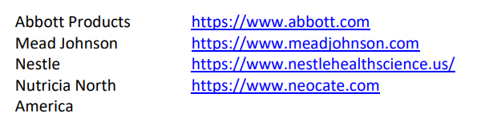
Possible Resources if Denied
Health Care Provider: Possible Social Worker, Clinic Nurse Manager Identify comparable formula on WIC Formulary HCP to work with Formula Manufacturer for Assistance
Community Resources: Family Case Manager, Financial or Food Assistance
Non-Medicaid Insurance Provider

Slide 15
This Photo by Unknown Author is licensed under CC BY
Thank You!
Please contact your Regional Nutritionist Consultant with questions

