Slide 1




USDA Infant Nutrition & Feeding Guide 2022
z
Chapters 1 & 2

Slide 2

Infant Nutrition & Feeding Guide
Where to find it
https://wicworks.fns.usda.gov/resources/infant-nutrition-and-feeding-guide

Slide 3


Slide 4

Chapters 1 & 2
Updates include:
Changes to current nutrient intake recommendations
Expanded content about the development of infant feeding skills

Slide 5


Chapter 1 Nutritional Needs of Infants
z

Slide 6

What is VENA?
New - "WIC's approach to dietary assessment is qualitative, not quantitative“
← Click the photo to learn more about VENA!
https://www.wellingtoncounselinggroup.com/images/hp/family.jpg

Slide 7

Trivia
What does the acronym VENA stand for?
A. Value Enhanced Nutrition Assessment
B. Virtual Edinburgh Nutrition Appraisal
C. Very Encouraging Nutrition Assistant
D. Virtual Electronic Nutrition Assignment

Slide 8

Trivia
What does the acronym VENA stand for?
A. Value Enhanced Nutrition Assessment
B. Virtual Edinburgh Nutrition Appraisal
C. Very Encouraging Nutrition Assistant
D. Virtual Electronic Nutrition Assignment

Slide 9
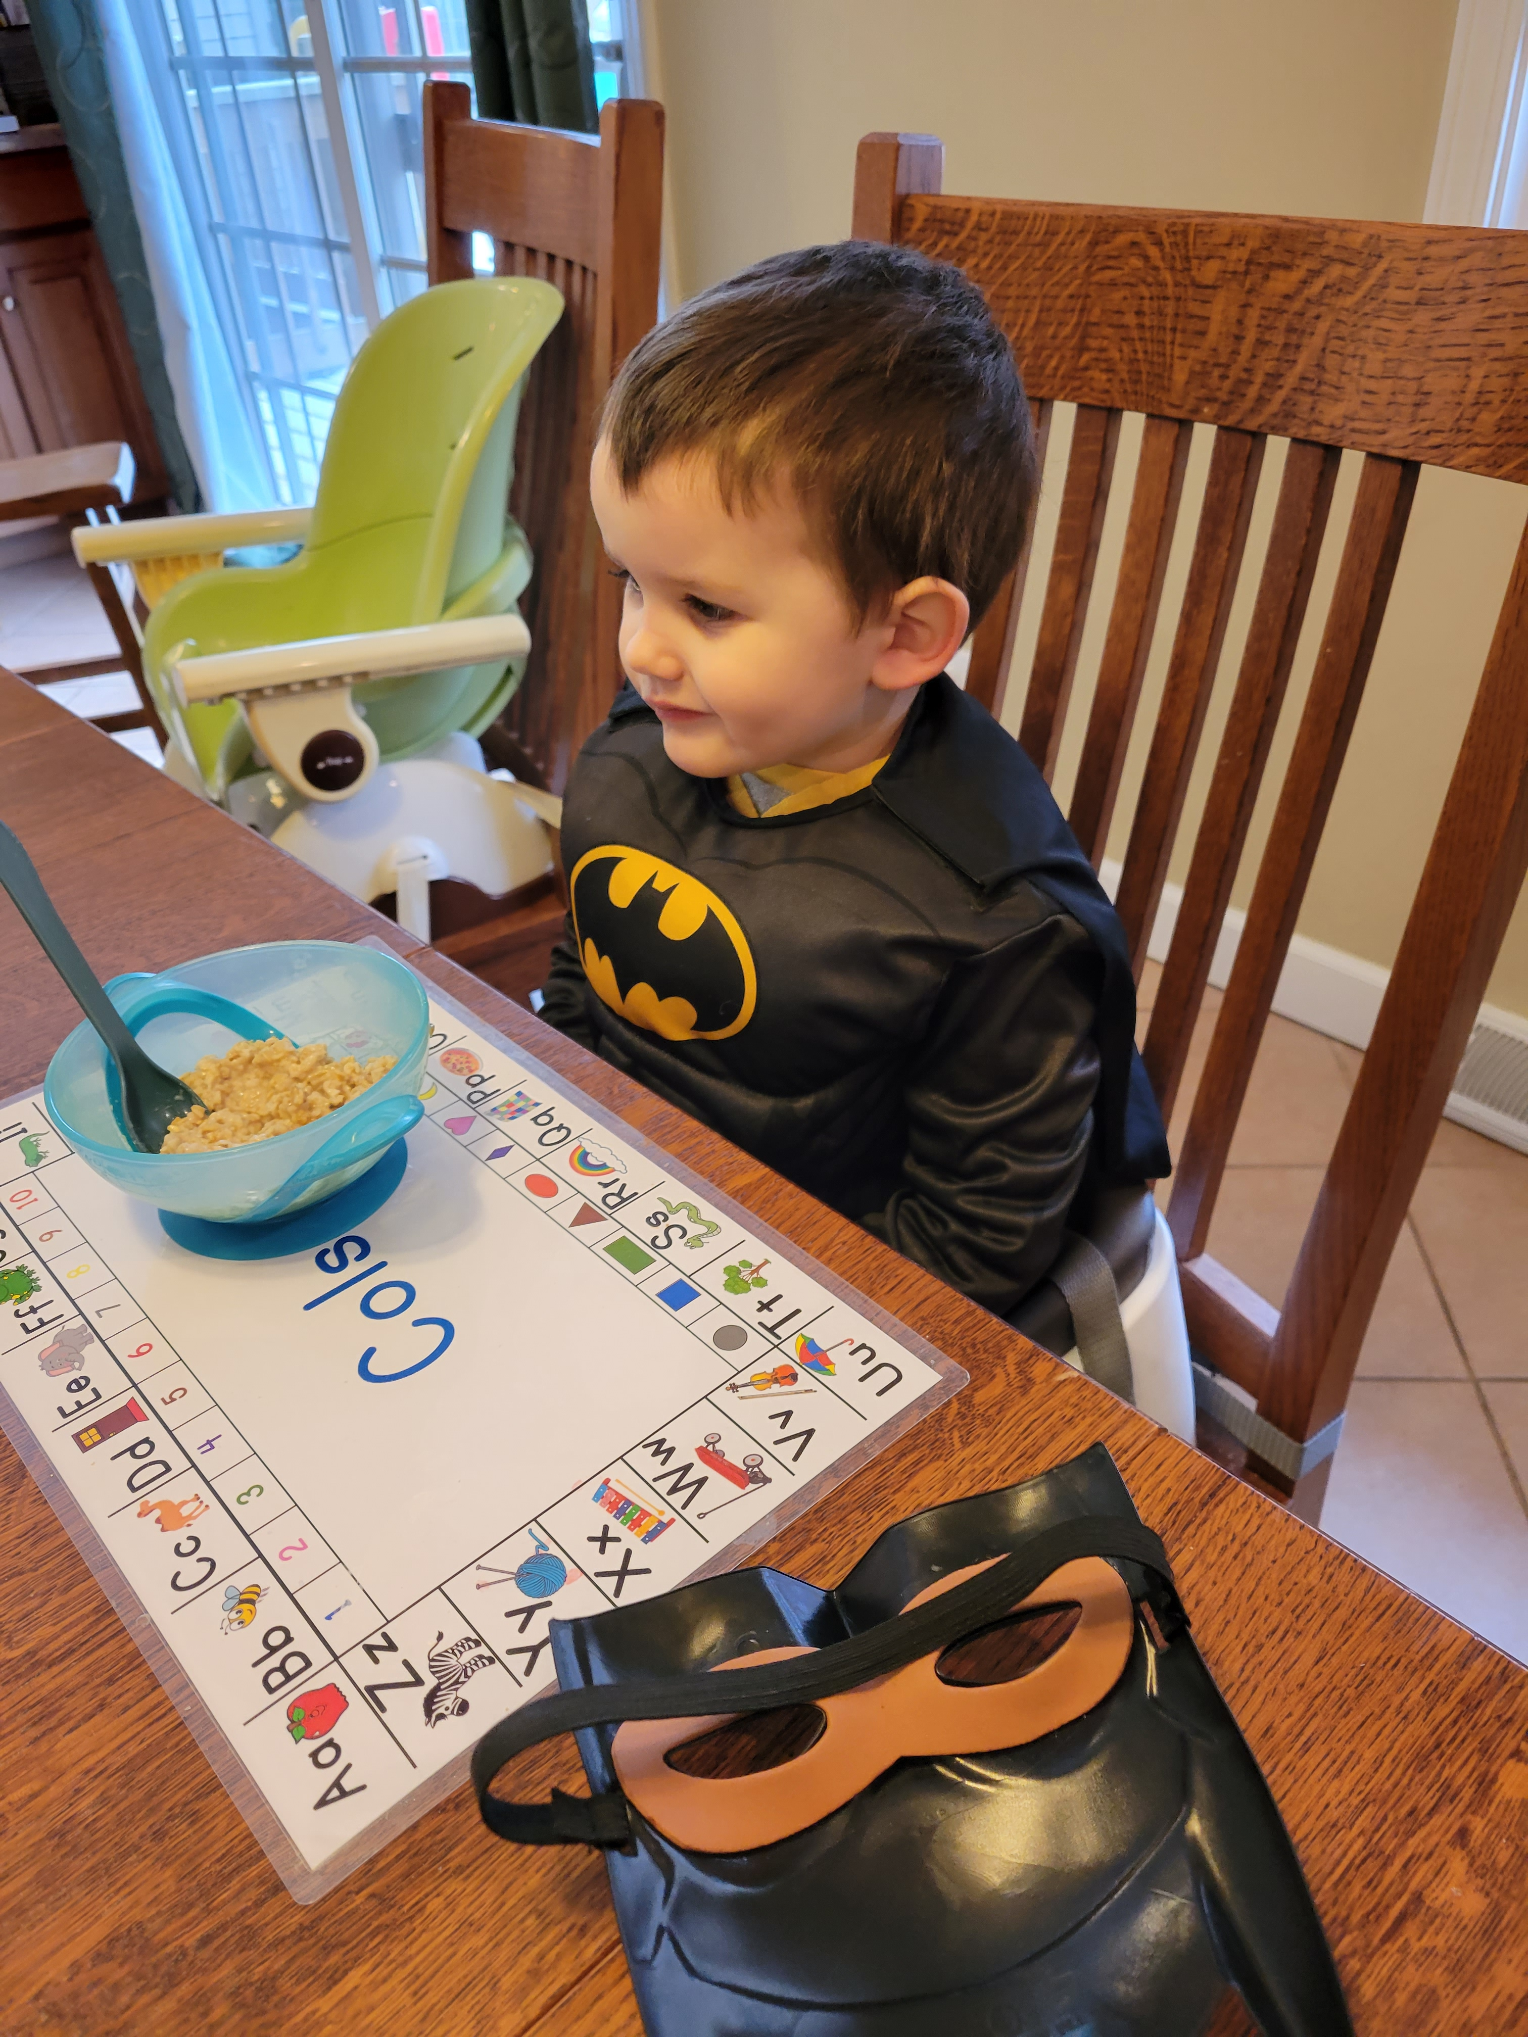

Vitamins & Minerals
z

Slide 10
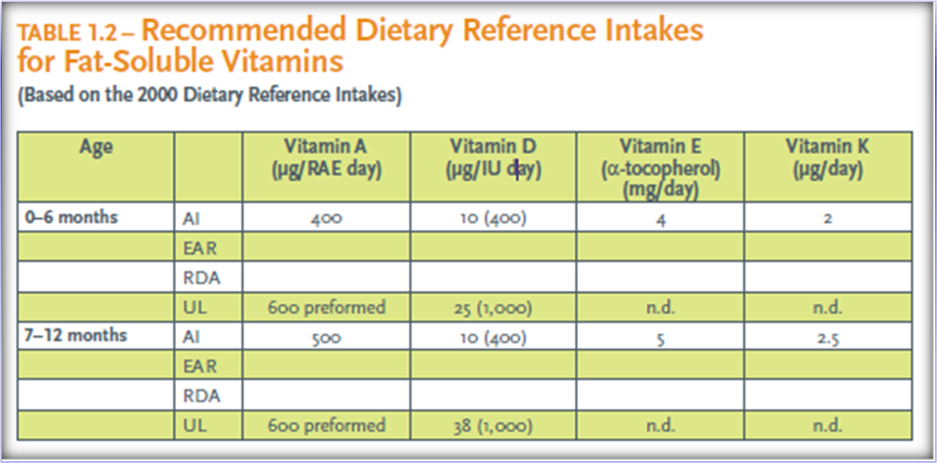
Vitamin D
Vitamin D AI for 0-12 months increased from 5 micrograms per day to 10 micrograms (400 IU) per day
Vitamin D UL was 25 micrograms 0-12 months but has been increased to 38 micrograms for infants 7-12 months of age

Slide 11
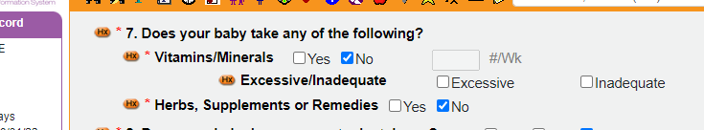
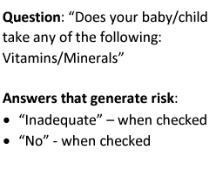
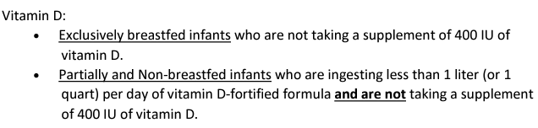
Vitamin D
z

Slide 12

Trivia
Which of the following is the function of Vitamin K that is new to the Infant Feeding Guide?
A. Immune cell enhancement
B. Bone resorption and deposition
C. Aids in bone mineralization for bone formation
D. Interferes with the utilization of iron

Slide 13

Trivia
Which of the following is the function of Vitamin K that is new to the Infant Feeding Guide?
A. Immune cell enhancement
B. Bone resorption and deposition
C. Aids in bone mineralization for bone formation
D. Interferes with the utilization of iron

Slide 14
Micronutrient Deficiencies & Resources
Added newly discovered deficiencies of Vitamin E, Vitamin K, Vitamin B1 (thiamin), Vitamin B3 (niacin), Vitamin B9 (folate), and Zinc
Vitamin B12 helps to convert folate to its active form
Current recommendations added on vitamin and mineral supplements
Shopping List added with specific food sources rich in various vitamins and minerals

Slide 15
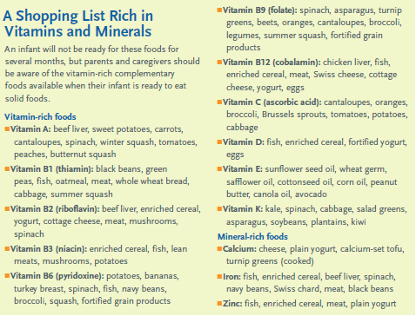
Micronutrient Deficiencies & Resources
z

Slide 16
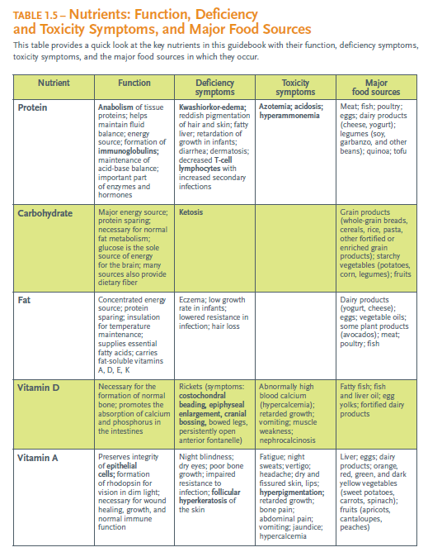
Nutrient Deficiencies & Resources

Slide 17
Iron
Recommendation for adding iron for exclusively breastfed infants changed from beginning iron-rich complementary foods at four months of age to:
"Parents and caregivers should be encouraged to talk with their health care providers about iron supplementation of 1mg/kg per day of oral iron beginning at four months of age until appropriate iron-containing complementary foods are introduced to the diet.”

Slide 18
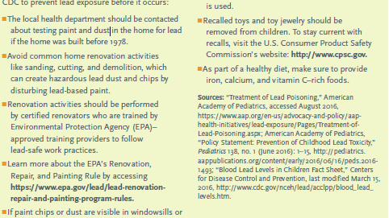
Iron
New - "Elevated blood lead levels may interfere with the utilization of iron, causing hypochromic normocytic anemia (lower than normal paler red blood cells)"
Avoiding lead toxicity updated

Slide 19
Water
Previous recommendation: Supplement 0.25 mg sodium fluoride per day in infants over 6 months when local drinking water contains less than 0.3 ppm fluoride
Updated recommendation: Health care provider to determine ‘appropriate’ supplementation when local drinking water contains less than 0.3 ppm fluoride

Slide 20
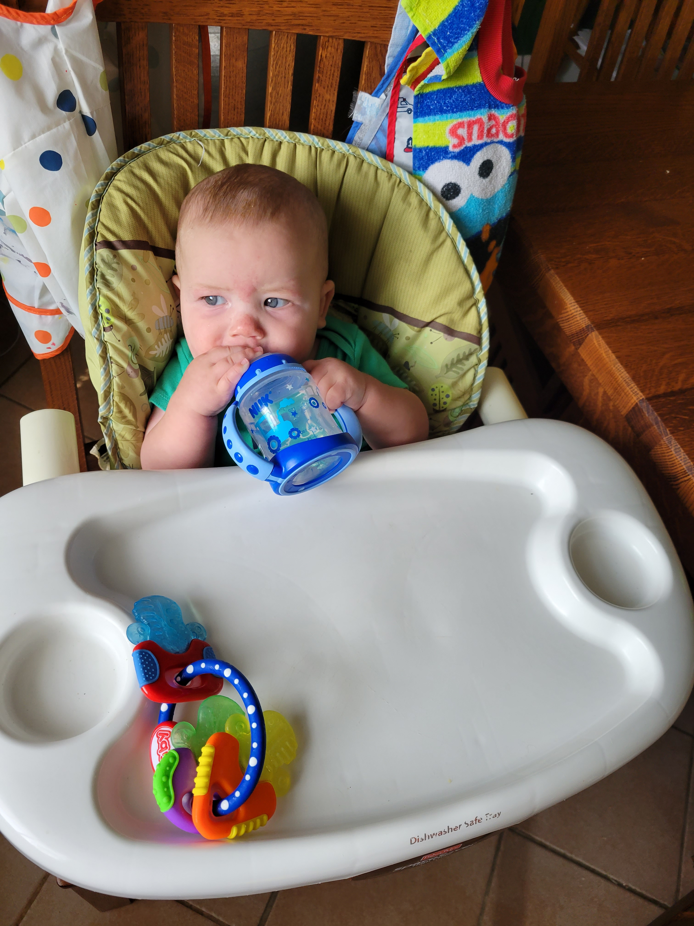
Water
"…infants under 6 months of age should not be given extra water."
From water sources for the older infant, 'sterile (boiled) water' was replaced with 'water'

Slide 21
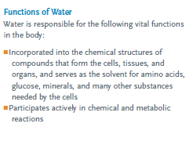
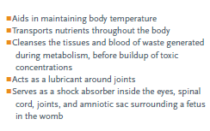
Water
z
Water AI for infants added, in addition to total body water percentage range recommendations

Slide 22
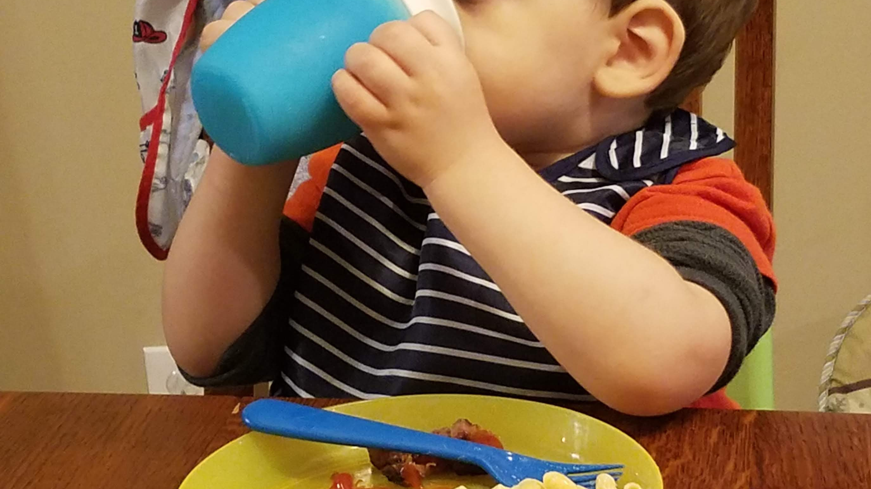
Other Nutritional Updates
AAP and NHLBI recommendation to avoid restricting fat in children under age two was dropped to under one year of age
"Human milk proteins have a high nutritional quality and are digested and absorbed more efficiently than proteins in infant formula”

Slide 23

Trivia
Which of the following is NOT true about relactation?
A. It is easiest when attempted before the infant is 6 months of age
B. Parents who have never nursed can relactate
C. Frequent breast stimulation and continued support are key to success
D. It is not possible if a mother did not nurse the baby within 48 hours after birth

Slide 24

Trivia
Which of the following is NOT true about relactation?
A. It is easiest when attempted before the infant is 6 months of age
B. Parents who have never nursed can relactate
C. Frequent breast stimulation and continued support are key to success
D. It is not possible if a mother did not nurse the baby within 48 hours after birth

Slide 25
Additional Resources & References
Websites:
2020-2025 Dietary Guidelines for Americans
WIC Learning Online modules and job aids
DHS Materials:
4340 – Well Fed Means Less Lead
4443 – Nutrient Sheet, Calcium
4444 – Nutrient Sheet, Iron
4429 – How to Get Your Children to Eat More Fruits & Vegetables

Slide 26
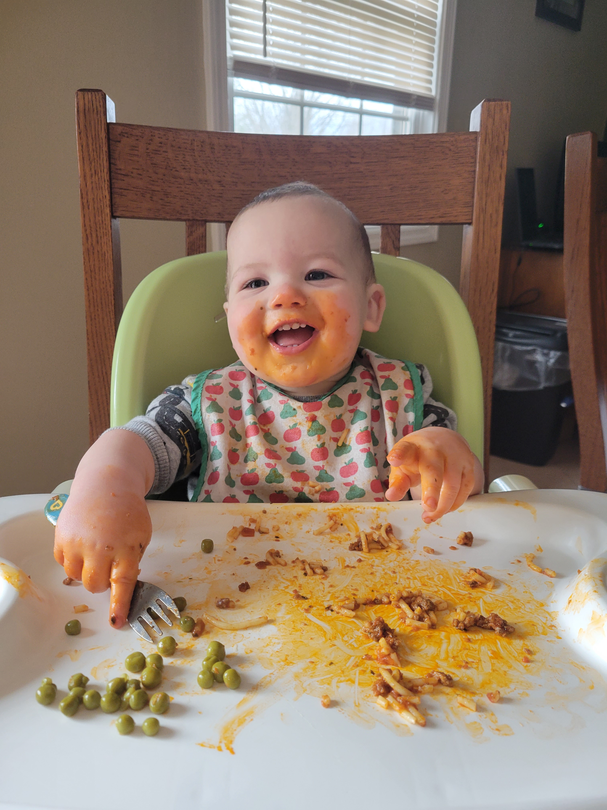

Chapter 2 Development of Infant Feeding Skills
z

Slide 27

Feeding Reflexes
Rooting reflex changes to voluntary behavior by around three weeks of age
Additional early reflexes to watch for
Tongue thrust reflex - helps protect the infant from choking

Slide 28

Baby’s latch
Expanded upon latch description, including two stages of sucking for letdown and drinking
https://www.google.com/url?sa=i&url=https%3A%2F%2Fdiatribe.org%2Funderstanding-gestational-diabetes&psig=AOvVaw0-J7DDleBpfQOIaAzzXQNM&ust=1652275998357000&source=images&cd=vfe&ved=0CAoQjhxqFwoTCNC26YuG1fcCFQAAAAAdAAAAABAI

Slide 29

Trivia
Which of the following is NOT true about the tongue thrust reflex
A. It is a sign that baby does not like a food
B. It protects an infant from choking
C. It disappears between 4-7 months of age
D. It is characterized by an infant’s tongue reflexively pushing food or objects back out of their mouth

Slide 30

Trivia
Which of the following is NOT true about the tongue thrust reflex
A. It is a sign that baby does not like a food
B. It protects an infant from choking
C. It disappears between 4-7 months of age
D. It is characterized by an infant’s tongue reflexively pushing food or objects back out of their mouth

Slide 31

New Pros & Cons of Pacifier Use
"Once satisfied, infants may suck on a pacifier - or their fingers. Nonnutritive sucking declines with increasing age, usually about age 4 to 5 years."
"…one potential benefit to use of a pacifier at infant nap to sleep time is a possible decreased risk of sudden infant death syndrome (SIDS).”
https://www.thebump.com/a/pacifier-pro-and-con
“It is recommended that pacifier use cease by 12 months because there are several potential problems…dental issues, increased risk of ear infections.”

Slide 32
Feeding Skill Development
z
Average age infants typically acquire certain feeding skills is no longer referenced
"How Developmental Delays Affect an Infant's Feeding Skills” has been added
Introduction of complementary foods was changed from '4-6 months' to 'around 6 months’
Role of family dysfunction in FTT is described

Slide 33
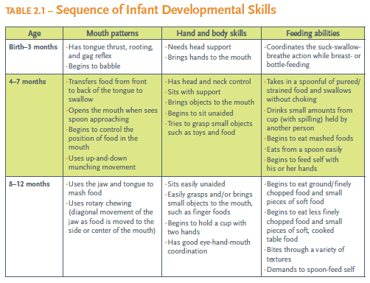
Table 2.1 Sequence of Infant Developmental Skills
z

Slide 34
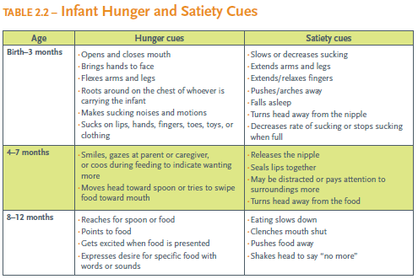
z
Table 2.2
Infant Hunger and Satiety Cues

Slide 35
Additional Resources & References
Websites
DHS Handouts
WIC Breastfeeding Support
WIC Learning Online
Infant Developmental Skills/Hunger and Satiety Cues Course
Infant Feeding Skills Quiz
4171 –Best for Baby
4369 – Feeding Your Baby Birth to 12 Months
Feeding Your Newborn
Next Foods
Paced Feeding
Time For a Cup
4876 – Look at Me Now 9-12 months

Slide 36
Infant Nutrition & Feeding Guide Chapters 1 & 2 Conclusion
How to use it:
Print or save to desktop
Ctrl + F to search
Snipping Tool for frequently referenced sections
Highlight

Slide 37
Congratulations! You have successfully completed Ch. 1 & 2 of the Infant Nutrition & Feeding Guide Update
This certificate is awarded to:
_______________________________
Completed on:
______________

